Slide 1
Operating Systems

Slide 2
Operating System Environments
Virtual machines (VMs)
  Software abstraction of a computer
  Often executes on top of native operating system
Virtual machine operating system
  Manages resources provided by virtual machine
Applications of virtual machines
  Allow multiple instances of an operating system to execute concurrently
  Emulation
    Software or hardware mimics functionality of hardware or software not present in system
  Promote portability

Slide 3
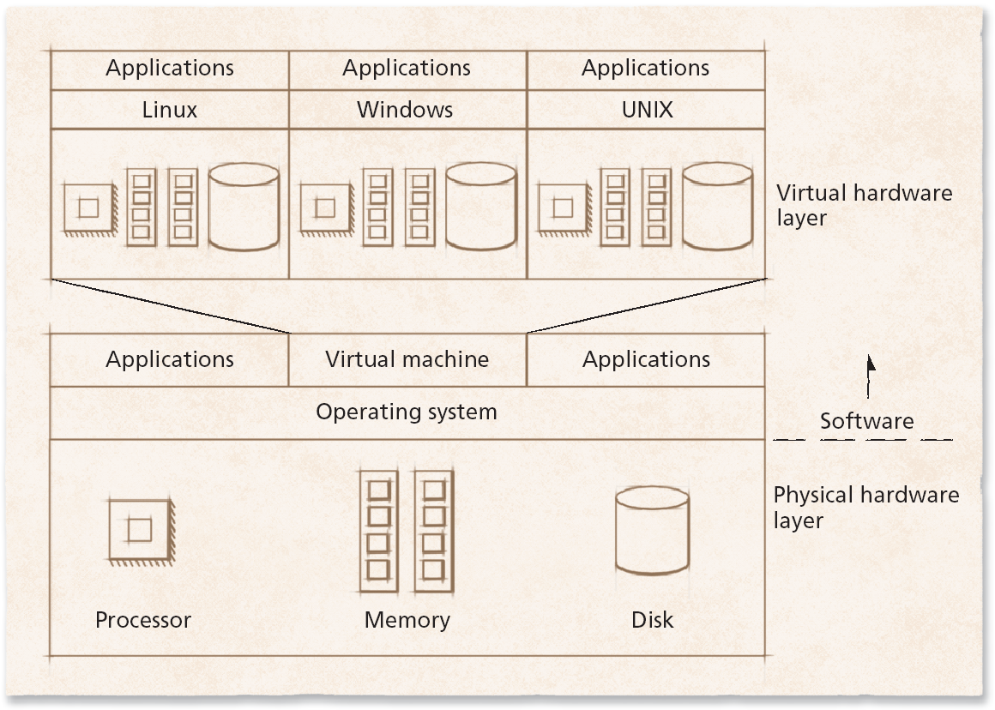
Operating System Environments
Figure 2 Schematic of a virtual machine.

Slide 4
Operating System Architectures
Today’s operating systems tend to be complex
  Provide many services
  Support variety of hardware and software
  Operating system architectures help manage this complexity
    Organize operating system components

Slide 5
KERNAL
Kernel is the core part of an operating system; it manages the system resources. Kernel is like a bridge between application and hardware of the computer. The Kernel can be classified further into two categories, Microkernel and Monolithic Kernel. Microkernel is the one in which user services and kernel services are kept in separate address space. However, in Monolithic kernel user services and kernel services both are kept in the same address space

Slide 6
Monolithic Architecture
Monolithic operating system
  Every component contained in kernel
    Any component can directly communicate with any other
  Tend to be highly efficient

Slide 7
The entire O.S. is placed inside the kernel
It runs as a single large process
As all the services are placed inside the kernel, they have a single address space
It is bigger in size
It is easy to implement/code
Performance is high (As kernel can invoke any function directly as everything is placed in the kernel)
Less Secure (If one service fails, entire system crashes)

Slide 8
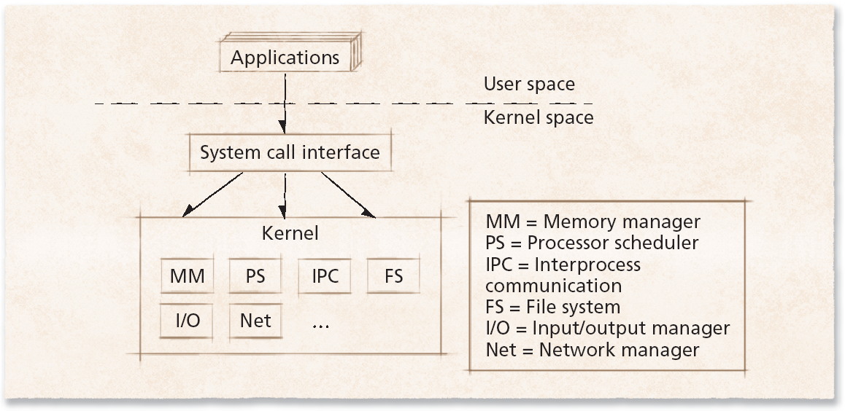
Monolithic Architecture
Figure 3 Monolithic operating system kernel architecture.

Slide 9
Layered Architecture
Layered approach to operating systems
  Tries to improve on monolithic kernel designs
    Groups components that perform similar functions into layers
  Each layer communicates only with layers immediately above and below it
  Processes’ requests might pass through many layers before completion
  System throughput can be less than monolithic kernels

Slide 10
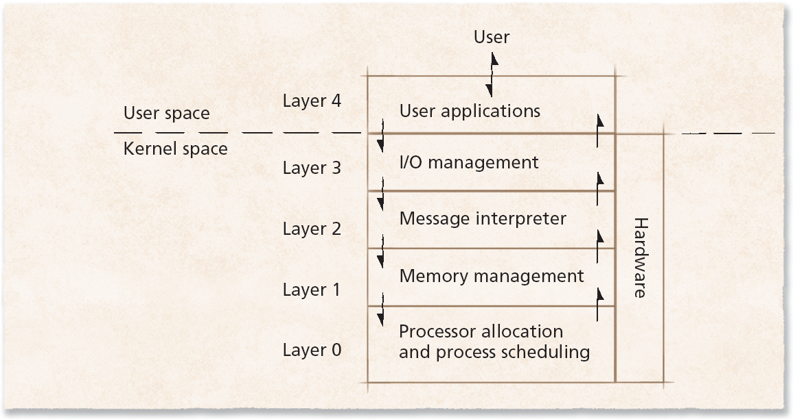
Layered Architecture
Figure 4 Layers of the operating system.

Slide 11
Microkernel Architecture
Microkernel operating system architecture
  Provides only small number of services
    Attempt to keep kernel small and scalable

Slide 12
Only bare minimum code is placed inside the kernel (only basic memory management and Inter Process Communication code)
Here the kernel is broken down into processes called as servers
As services(Servers provide services) are separated they have different address spaces
It is smaller in size
It is tough to implement/code
Performance is low (As servers are separated, so to invoke services from other servers IPC(Inter Process Communication) is needed which requires kernel's permission and thus increases access time and lowers the performance)
More Secure (Even if one service crashes, others can function properly because of separation)

Slide 13
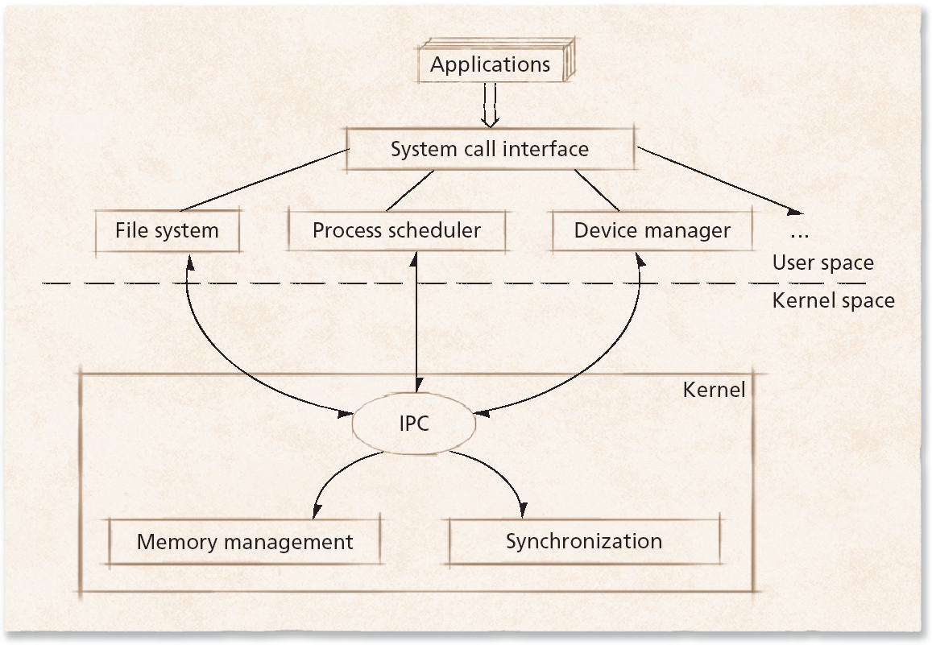
Microkernel Architecture
Figure 5 Microkernel operating system architecture.

Slide 14
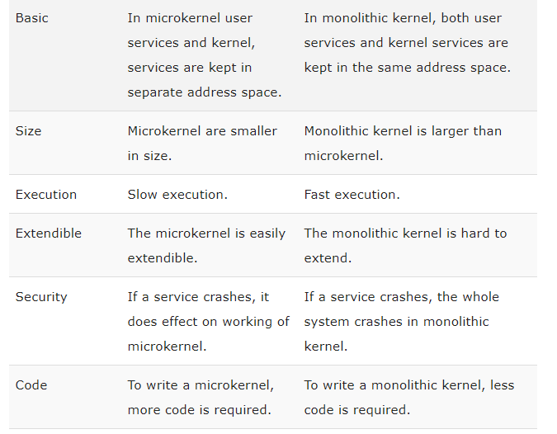


Slide 15
